Slide 1

DIGITAL LOGIC DESIGN (111776)
Dr. Owais Hussain

Slide 2

Agenda
Half Adders/Subtractors
Full Adders/Subtractors
Parallel Binary Adders
Multipliers

Slide 3
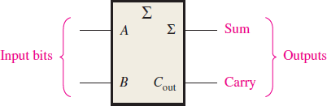
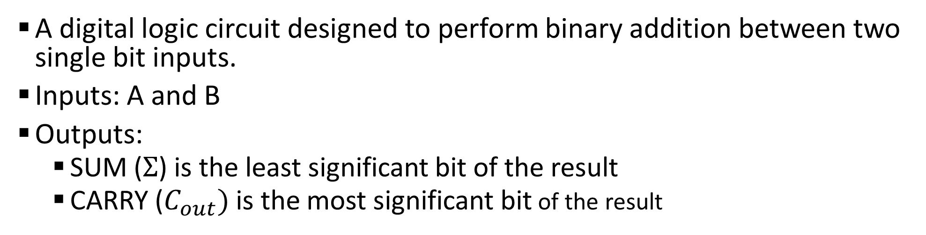
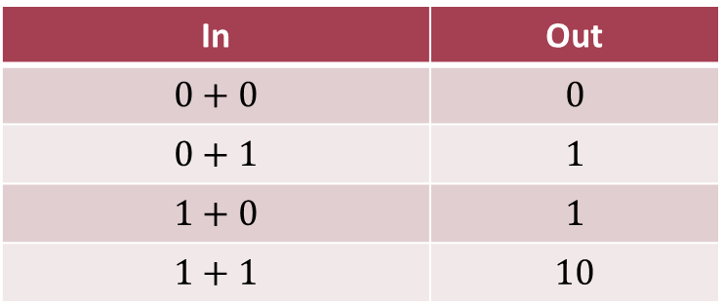
Sample 2
Half Adder
A digital logic circuit designed to perform binary addition between two single bit inputs.
Inputs: A and B
Outputs:
SUM ($Σ$) is the least significant bit of the result
CARRY ($C_{out})$ is the most significant bit of the result
In | Out
$$0+0$$ | $$0$$
$$0+1$$ | $$1$$
$$1+0$$ | $$1$$
$$1+1$$ | $$10$$
Notes:
Most significant bit is the bit of highest value: Left-most True bit
Least significant bit is the bit of lowest value: Right-most True bit

Slide 4
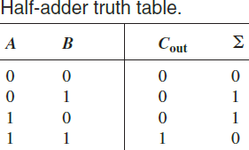
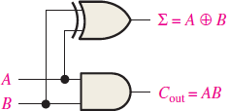
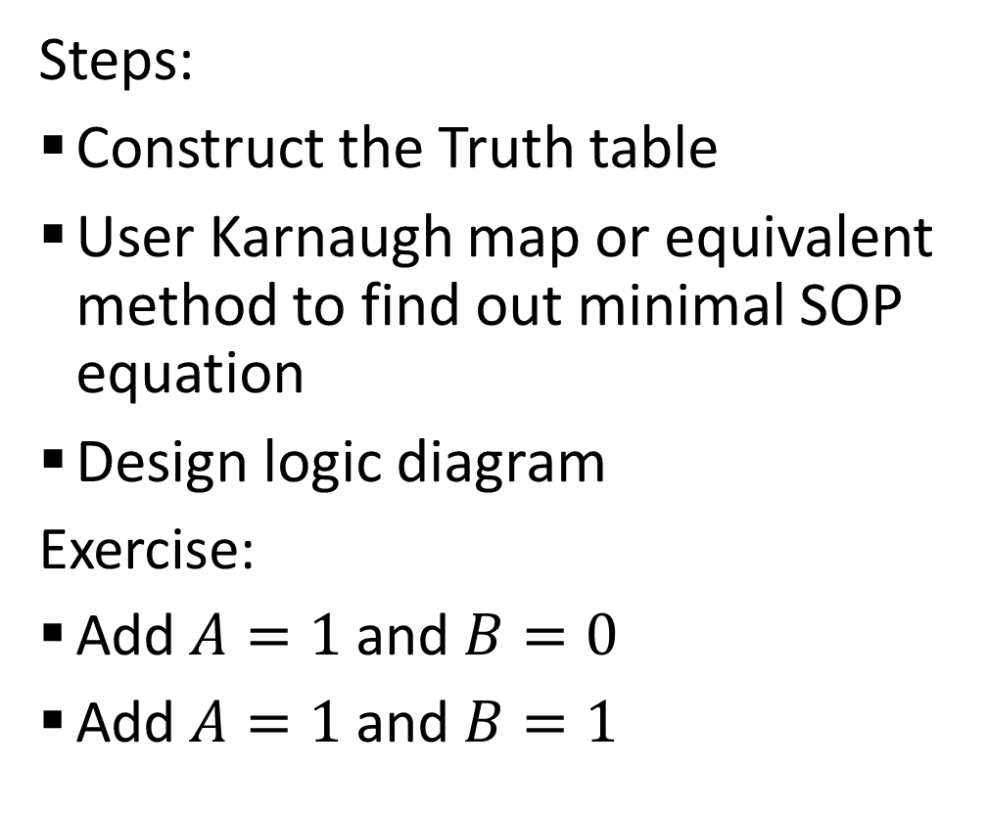
Sample 2
Half Adder
Steps:
Construct the Truth table
User Karnaugh map or equivalent method to find out minimal SOP equation
Design logic diagram
Exercise:
Add $A=1$ and $B=0$
Add $A=1$ and $B=1$
Notes:
Most significant bit is the bit of highest value: Left-most True bit
Least significant bit is the bit of lowest value: Right-most True bit
Introduce the concept of cross-pairing in K-map for XOR gate

Slide 5
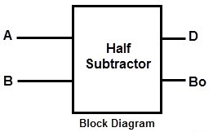
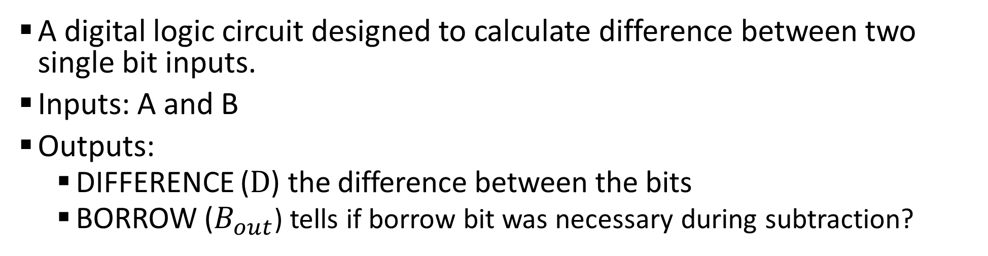
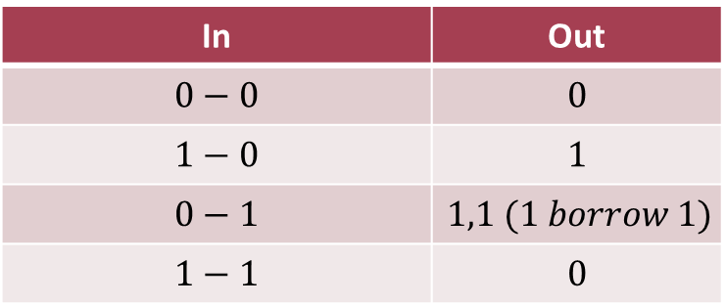
Sample 2
Half Subtractor
A digital logic circuit designed to calculate difference between two single bit inputs.
Inputs: A and B
Outputs:
DIFFERENCE ($D$) the difference between the bits
BORROW ($B_{out}$) tells if borrow bit was necessary during subtraction?
In | Out
$$0−0$$ | $$0$$
$$1−0$$ | $$1$$
$$0−1$$ | $$1,1 (1 borrow 1)$$
$$1−1$$ | $$0$$

Slide 6
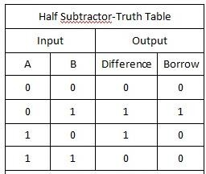
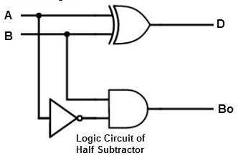
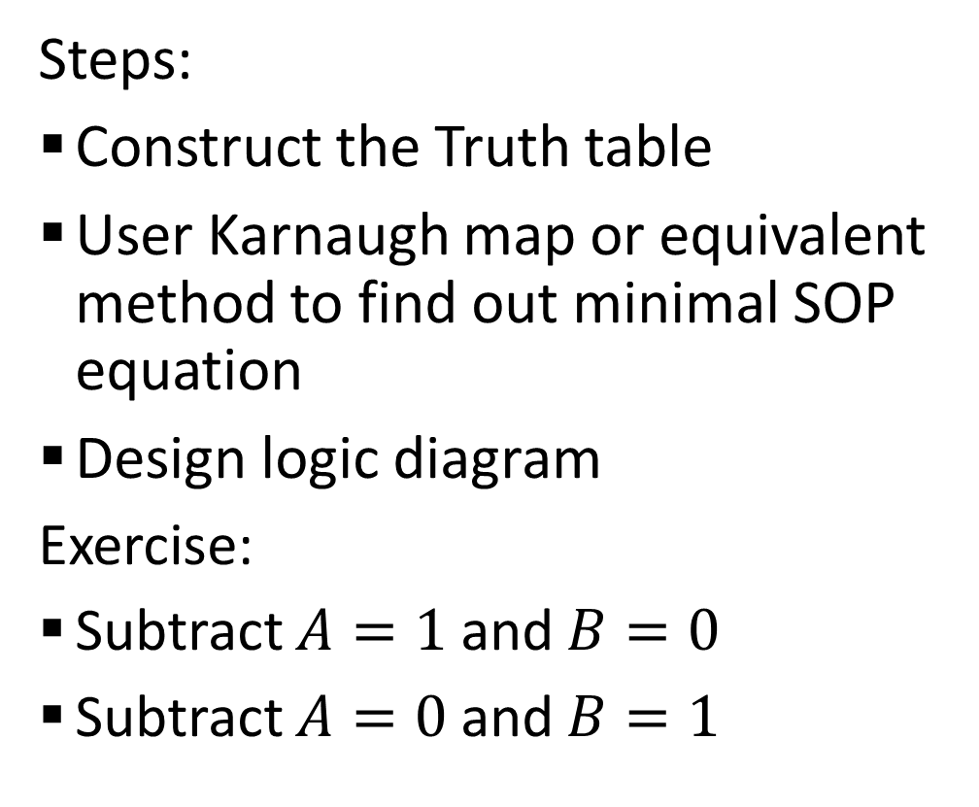
Sample 2
Half Subtractor
Steps:
Construct the Truth table
User Karnaugh map or equivalent method to find out minimal SOP equation
Design logic diagram
Exercise:
Subtract $A=1$ and $B=0$
Subtract $A=0$ and $B=1$

Slide 7

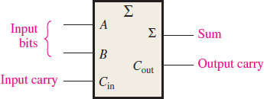
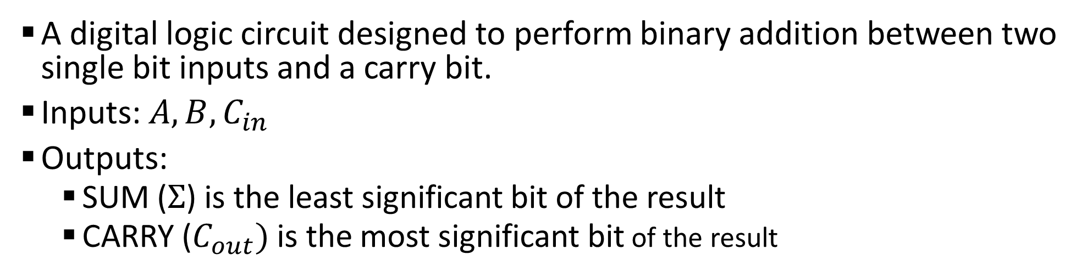
Sample 2
Full Adder
A digital logic circuit designed to perform binary addition between two single bit inputs and a carry bit.
Inputs: $A, B, C_{in}$
Outputs:
SUM ($Σ$) is the least significant bit of the result
CARRY ($C_{out})$ is the most significant bit of the result
Carry-input Bit
Two-input Bits
Carry- Output Bit
Sum- Output Bit
Notes:
Think of the operation to be like performing addition twice

Slide 8
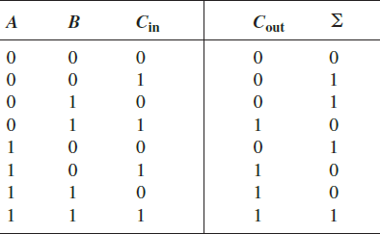
Sample 2
Full Adder
Steps:
Construct the Truth table
User Karnaugh map or equivalent method to find out minimal SOP equation

Slide 9
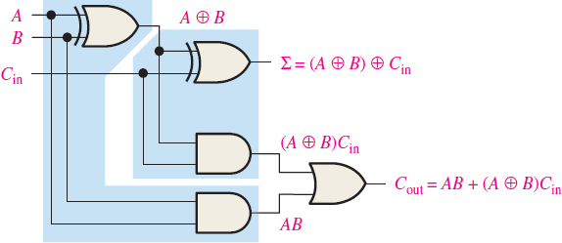

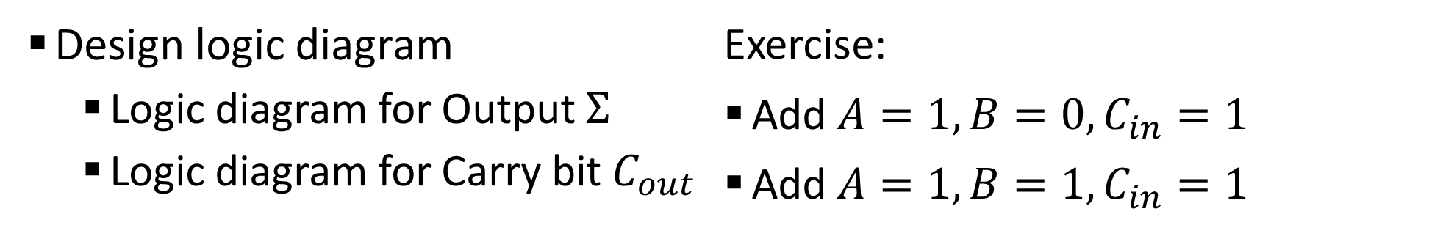
Sample 2
Full Adder
Design logic diagram
Logic diagram for Output $Σ$
Logic diagram for Carry bit $C_{out}$
Exercise:
Add $A=1,B=0,C_{in}=1$
Add $A=1,B=1,C_{in}=1$

Slide 10
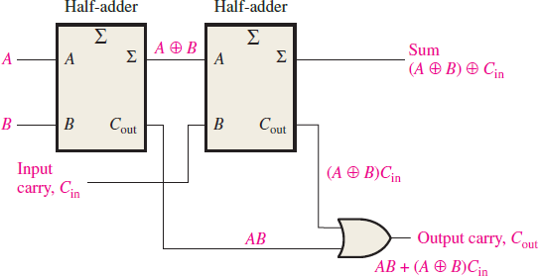
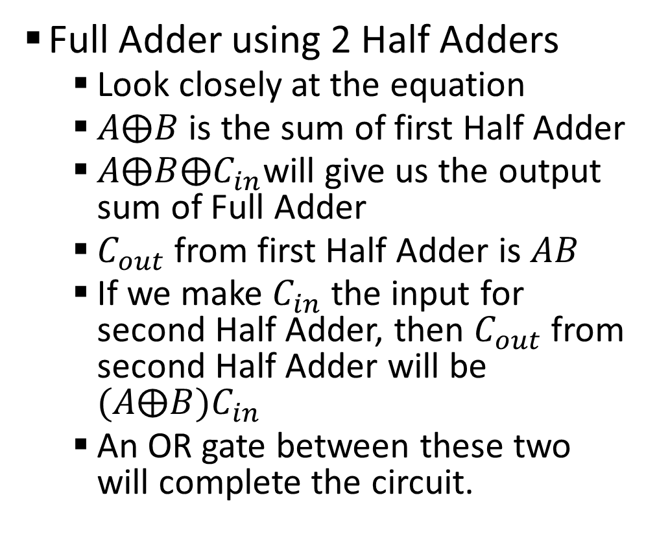
Sample 2
Full Adder
Full Adder using 2 Half Adders
Look closely at the equation
$A⨁B$ is the sum of first Half Adder
$A⨁B⨁C_{in}$will give us the output sum of Full Adder
$C_{out}$ from first Half Adder is $AB$
If we make $C_{in}$ the input for second Half Adder, then $C_{out}$ from second Half Adder will be $(A⨁B)C_{in}$
An OR gate between these two will complete the circuit.

Slide 11
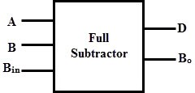
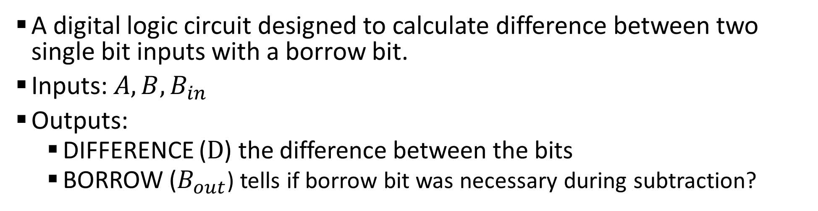
Sample 2
Full Subtractor
A digital logic circuit designed to calculate difference between two single bit inputs with a borrow bit.
Inputs: $A, B, B_{in}$
Outputs:
DIFFERENCE ($D$) the difference between the bits
BORROW ($B_{out}$) tells if borrow bit was necessary during subtraction?
Notes:
Think of the operation to be like performing addition twice

Slide 12
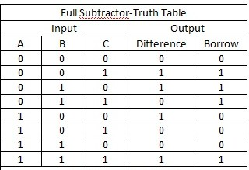
Sample 2
Full Subtractor
Steps:
Construct the Truth table
User Karnaugh map or equivalent method to find out minimal SOP equation
Notes:
$D=\left(A⨁B\right)⨁B_{in}$
$B_{out}=\left(A⨁B\right)B_{in}+\overline{A}B$

Slide 13
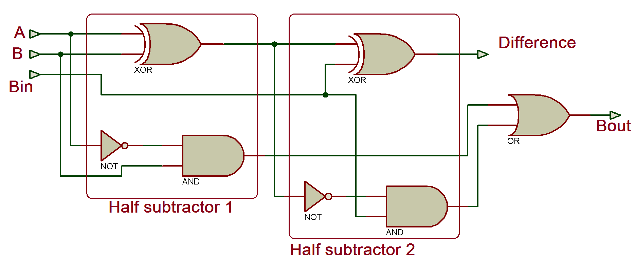
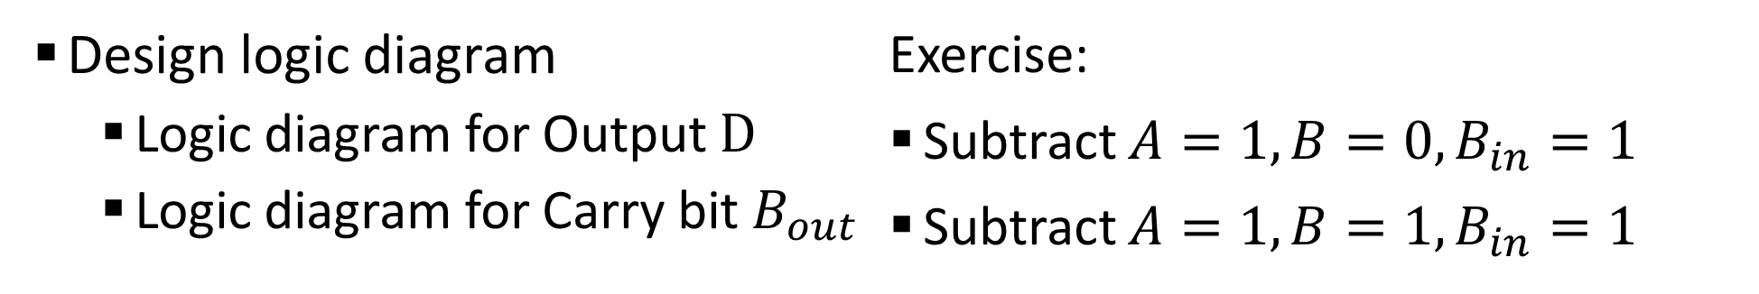
Sample 2
Full Subtractor
Design logic diagram
Logic diagram for Output $D$
Logic diagram for Carry bit $B_{out}$
Exercise:
Subtract $A=1,B=0,B_{in}=1$
Subtract $A=1,B=1,B_{in}=1$

Slide 14
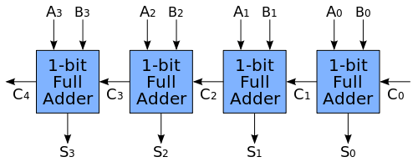
Sample 2
Parallel Adders
An Adder circuit can Sum two single bit inputs. How to Add more than 1 bit?
To add 2-bit inputs, we need 2 Full Adders. For 4-bit inputs, 4 Full Adders.
Notes:
Tip! The first one can also be a Half Adder because there will never be a Carry for it.

Slide 15
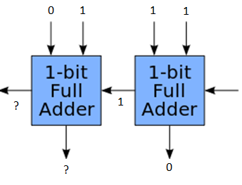
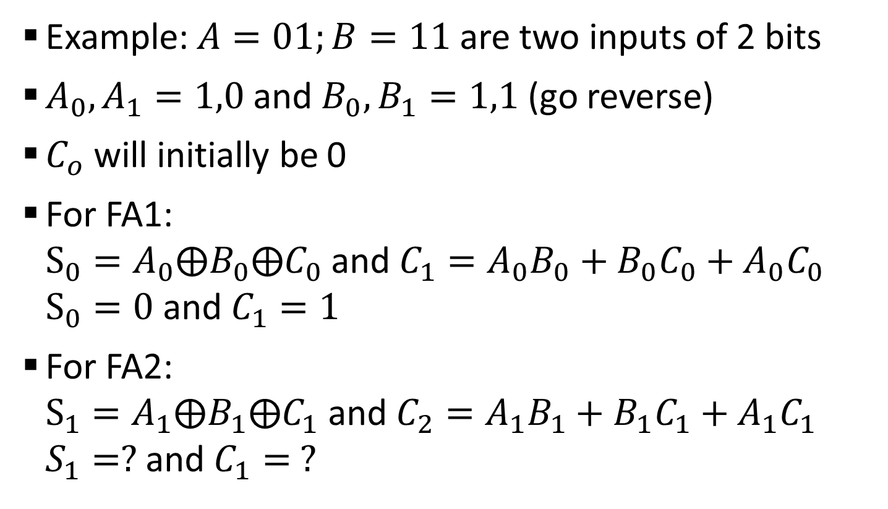
Sample 2
Parallel Adders
Example: $A=01;B=11$ are two inputs of 2 bits
$A_{0},A_{1}=1,0$ and $B_{0},B_{1}=1,1$ (go reverse)
$C_{o}$ will initially be 0
For FA1: $S_{0}=A_{0}⨁B_{0}⨁C_{0}$ and $C_{1}=A_{0}B_{0}+B_{0}C_{0}+A_{0}C_{0}$ $S_{0}=0$ and $C_{1}=1$
For FA2: $S_{1}=A_{1}⨁B_{1}⨁C_{1}$ and $C_{2}=A_{1}B_{1}+B_{1}C_{1}+A_{1}C_{1}$ $S_{1}=?$ and $C_{1}= ?$
Notes:
Tip! The first one can also be a Half Adder because there will never be a Carry for it.

Slide 16
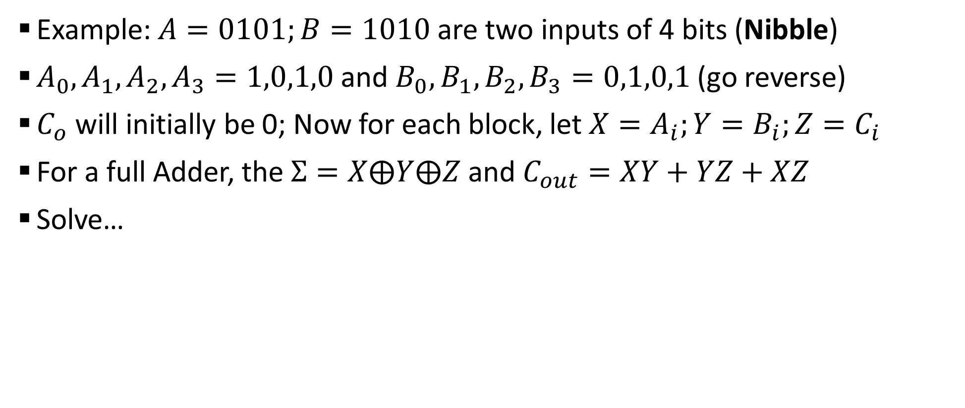
Sample 2
Parallel Adders
Example: $A=0101;B=1010$ are two inputs of 4 bits (Nibble)
$A_{0},A_{1},A_{2},A_{3}=1,0,1,0$ and $B_{0},B_{1},B_{2},B_{3}=0,1,0,1$ (go reverse)
$C_{o}$ will initially be 0; Now for each block, let $X=A_{i};Y=B_{i};Z=C_{i}$
For a full Adder, the $Σ=X⨁Y⨁Z$ and $C_{out}=XY+YZ+XZ$
Solve…

Slide 17
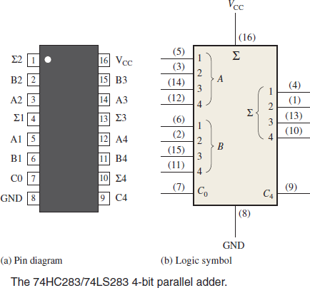
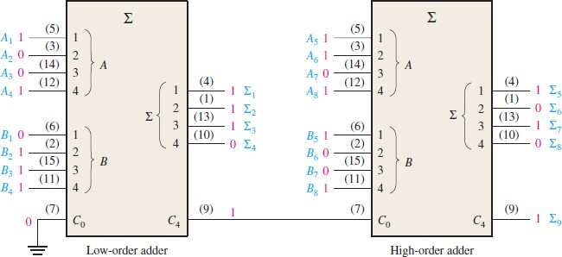
Sample 2
Parallel Adders
The Pin diagram and logic symbol for 74HC283/74LS283, a 4-bit parallel adder IC
Can you tell how to make 8-bit parallel adder by using two of these?
DIY: Create a 12-bit parallel adder using this IC

Slide 18
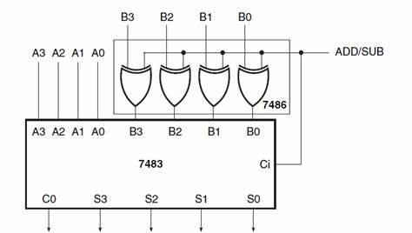
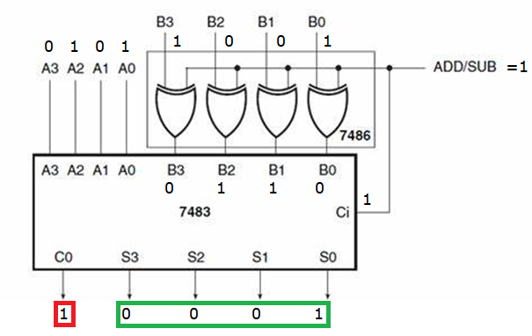
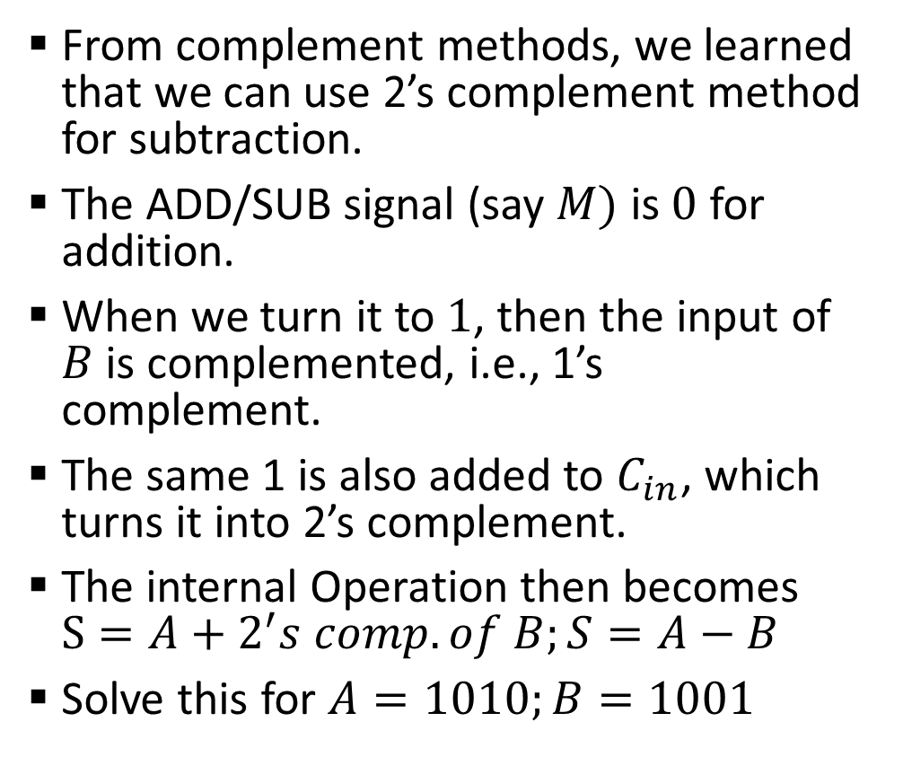
Sample 2
Parallel Adders – Subtraction
From complement methods, we learned that we can use 2’s complement method for subtraction.
The ADD/SUB signal (say $M)$ is $0$ for addition.
When we turn it to $1$, then the input of $B$ is complemented, i.e., 1’s complement.
The same 1 is also added to $C_{in}$, which turns it into 2’s complement.
The internal Operation then becomes $S=A+2^{′}s comp. of B;S=A−B$
Solve this for $A=1010;B=1001$

Slide 19
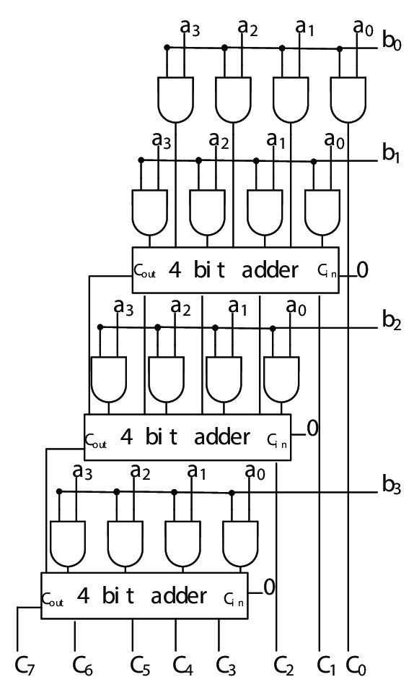
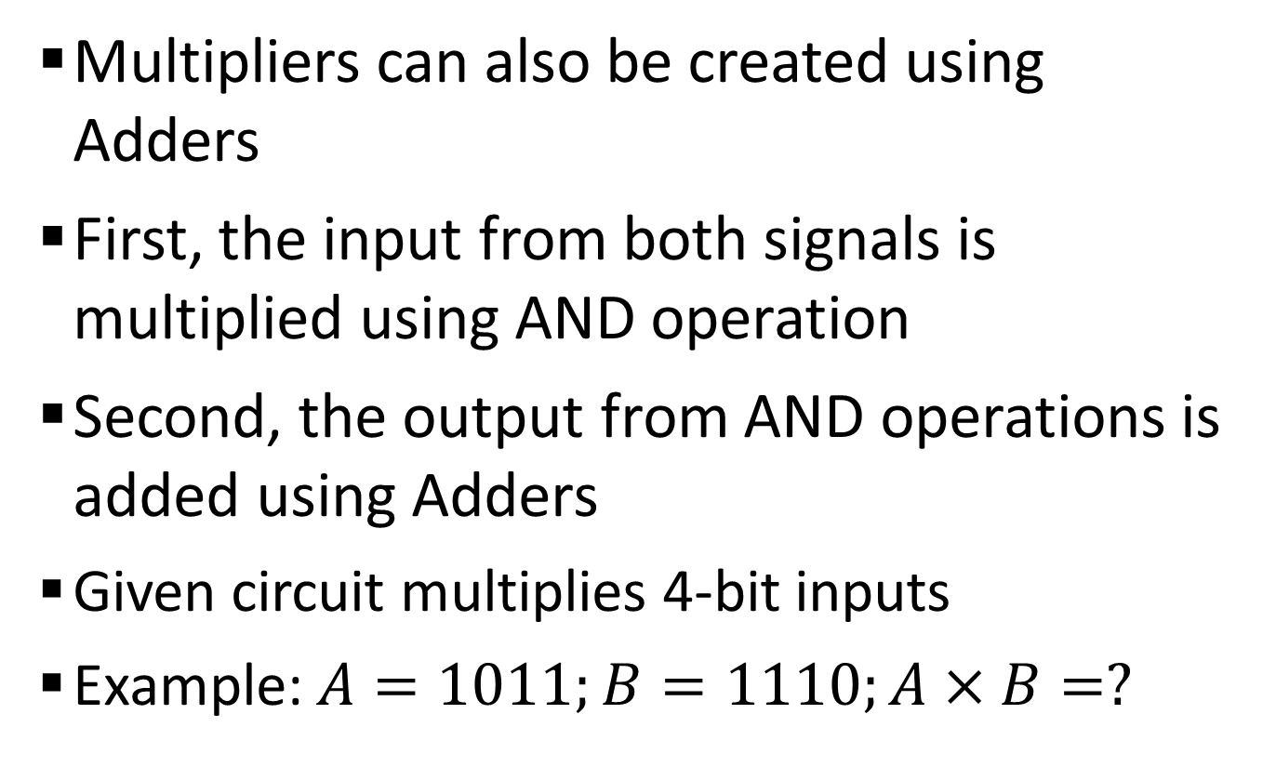
Sample 2
Multipliers
Multipliers can also be created using Adders
First, the input from both signals is multiplied using AND operation
Second, the output from AND operations is added using Adders
Given circuit multiplies 4-bit inputs
Example: $A=1011;B=1110;A×B=?$

Slide 20
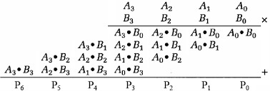

Sample 2
AND
Adder
$$C_{6} C_{5} C_{4} C_{3} C_{2} C_{1} C_{0}$$

Slide 21
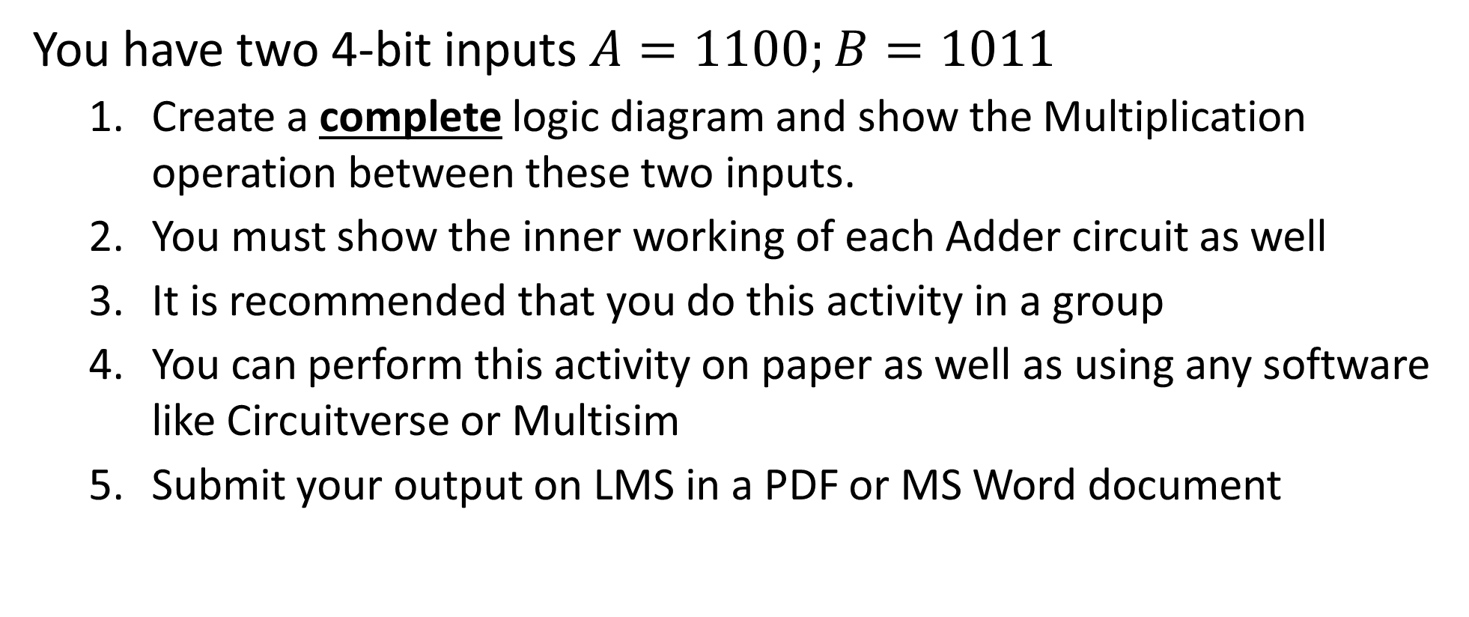
Sample 2
Activity 3
You have two 4-bit inputs $A=1100;B=1011$
Create a complete logic diagram and show the Multiplication operation between these two inputs.
You must show the inner working of each Adder circuit as well
It is recommended that you do this activity in a group
You can perform this activity on paper as well as using any software like Circuitverse or Multisim
Submit your output on LMS in a PDF or MS Word document

Slide 22



THANK YOU
Owais Hussain
+92 345-3174270
owais.hussain@kiet.edu.pk
https://www.researchgate.net/profile/Owais-Hussain-3

